Slide 1
CHAPTER 3: Other Construction and Destruction Techniques, Operator Overloading

Slide 2
Plan
Construction techniques
Factory methods
Object copying
Destruction techniques
Context managers
Resource management libraries
Operator overloading

Slide 3
Construction Techniques
The default way to create objects from classes is using the constructor (__init__) method.
Apart from constructors, there are other ways that instances can be created from classes.
These include; using factory methods and using object copying
Factory methods are class methods that return an instance of the class.
They provide flexibility in object creation by allowing different ways to create objects.

Slide 4
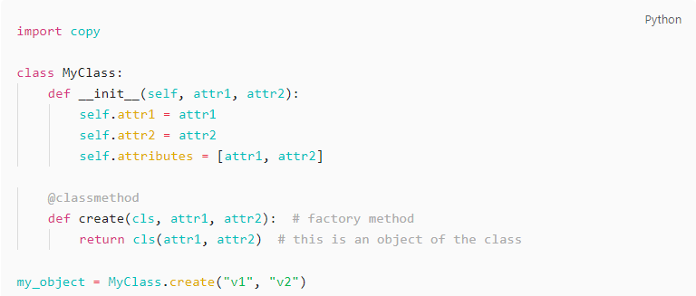
Construction Techniques - Factory method
Factory method

Slide 5
Construction Techniques - Object copying
You can create an object from another existing object using copying. The copied object has the same attributes as the original
There are 2 types of copying, shallow (copy.copy()) and deep copying (copy.deepcopy()).
Add the following code to the end of the file with the code from the previous slide
The code is meant to illustrate the difference in behavior when shallow copying and deep copying objects with mutable attributes.

Slide 6
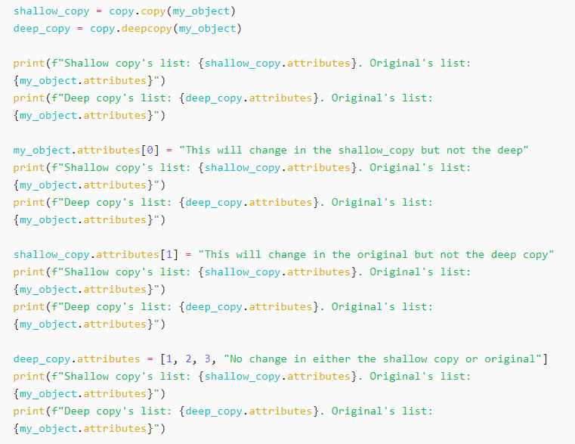
Construction Techniques - Object copying

Slide 7
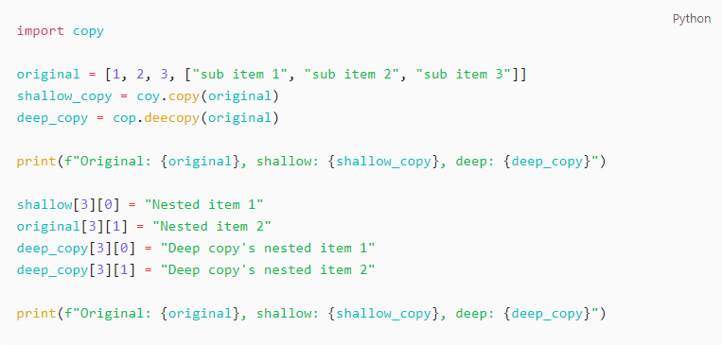
Construction Techniques - Object copying
Object copying with lists and nested list (there are errors in this code snippet, should be light work for Python devs like you)

Slide 8
Destruction techniques
__del__ method, context managers, resource management libraries

Slide 9
Destruction techniques - __del__
A constructor creates, a destructor destroys objects when they are no longer in use. The destructor method in Python is the __del__.
You can use this method to perform special operations when an object is no longer in use.
The __del__() method is automatically called when the reference count of an object reaches 0.
Other destruction techniques include context managers and special libraries.

Slide 10

Destruction techniques - __del__
We’ll modify our class created above by creating a class attribute and destructor method.
The class method should be called count, with initial value 0.
Add this line to the end of the __init__ method of the MyClass class: self.__class__.count += 1. This increases the count by 1 every time a new object is created.
Add the following __del__ method to the class.

Slide 11
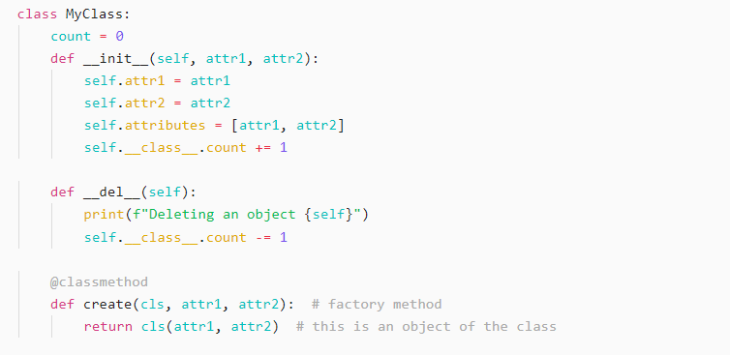
Destruction techniques - __del__
The class should look like this at the end

Slide 12
Destruction techniques - context managers
Context managers allow to allocate and release resources. They are typically used with the `with` statement
Context managers are created by implementing two special methods: __enter__() and __exit__()
Resources are automatically released when exiting the `with` block, even if an exception occurs.

Slide 13
Destruction techniques - context managers
Context managers allow to allocate and release resources. They are typically used with the `with` statement
Context managers are created by implementing two special methods: __enter__() and __exit__()
Resources are automatically released when exiting the `with` block, even if an exception occurs.
You can create your own context manager functionality by implementing the __enter__ and __exit__ methods in you class. It is a bit out of the scope of this class.

Slide 14
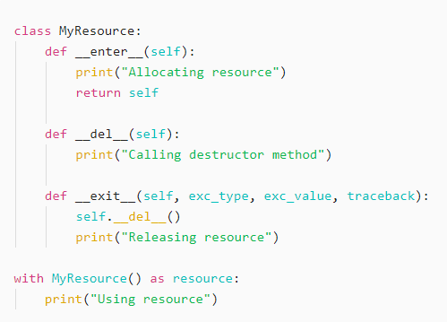

Destruction techniques - context managers
Output

Slide 15
Destruction techniques - libraries
There are Python libraries designed for managing specific types of resources.
Such as file handling (with open() for file I/O), database connections (contextlib.closing()) and networks sockets(socketserver module)

Slide 16
Operator overloading
dunder methods

Slide 17
Operator overloading
A type of compile-time polymorphism that allows developers to define custom behavior for built-in operators like +, -, *. /, ==, != etc.
It is achieved by defining special methods with double underscore (dunder methods)
Each operator has a corresponding dunder method e.g. __add__() for +, __mul__() for *, and so on
Operator overloading is not passed down through inheritance, it needs to be explicitly defined for subclasses.

Slide 18
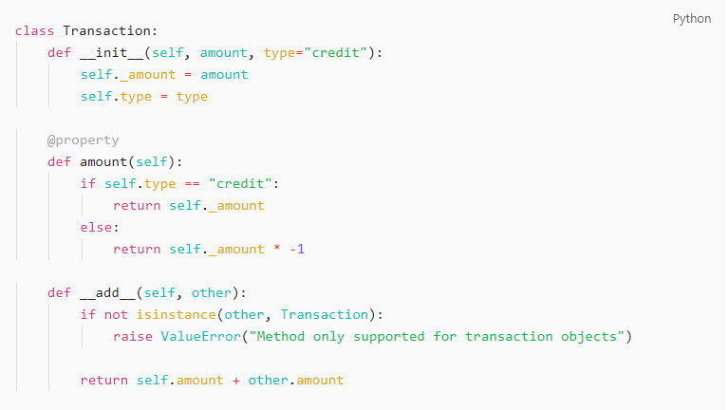
Operator overloading

Slide 19
Exercise
Factory methods, operator overloading

Slide 20


